Slide 1




FLOOD MONITORING AND EARLY WARNING
DEPARTMENT OF COMPUTER SCIENCE AND ENGINEERING
TEAM MEMBERS: RAMKUMAR N RANJITH Y SANTHOSH K SANTHOSH N
Proj_224785_Team_2
(113321104079)
(113321104080)
(113321104085)
(113321104086)

Slide 2
PROBLEM DEFINITION
The Flood Monitoring and Early Warning System is an advanced IoT- based solution designed to monitor water levels in flood-prone areas, predict potential floods, and issue timely warnings to residents and emergency response teams. By deploying a network of IoT sensors near water bodies, this project aims to significantly enhance flood preparedness, minimize property damage, and ensure the safety of vulnerable communities.

Slide 3
OBJECTIVES
Real-Time Monitoring:
Objective: Implement a network of sensors to monitor water levels in real time.
Rationale: Real-time monitoring provides accurate and immediate data, essential for timely decision-making during flood events.
Early Warning Issuance:
Objective: Develop algorithms to predict and identify potential flood situations and issue early warnings.
Rationale: Early warnings provide residents and authorities with crucial time to prepare, evacuate, and respond effectively
DataAnalysis and Prediction:
Objective: Analyze historical and real-time data to create predictive models for flood events.
Rationale: Predictive analytics help in understanding patterns, enabling proactive measures to be taken in high-risk periods.
User-Friendly Interface:
Objective: Develop an intuitive interface for users to access real-time data, alerts, and evacuation information.
Rationale: A user-friendly interface ensures that residents can easily understand the information provided and take
necessary actions

Slide 4
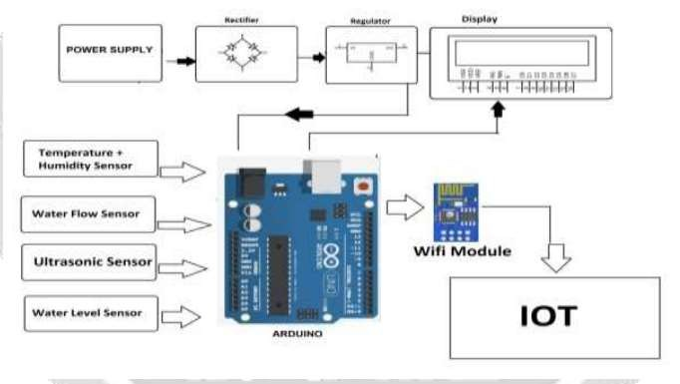
IOT SENSOR DESIGN

Slide 5
IOT SENSOR DESIGN
To detect a flood the system observes various natural factors, which includes humidity, temperature, water level and flow level. To collect data of mentioned natural factors the system consist of different sensors which collects data for individual parameters. For detecting changes in humidity and temperature the system has a DHT11 Digital Temperature Humidity Sensor. It is a advanced sensor module with consists of resistive humidity and temperature detection components. The water level is always under observation by a float sensor, which work by opening and closing circuits (dry contacts) as water levels rise and fall. It normally rest in the closed position, meaning the circuit is incomplete and no electricity is passing through the wires yet. Once the water level drops below a predetermined point, the circuit completes itself and sends electricity through the completed circuit to trigger an alarm. The flow sensor on the system keeps eye on the flow of water. The water flow sensor consists of a plastic valve body, a water rotor, and a hall-effect sensor. When water flows through the rotor, rotor rolls. Its speed changes with different rate of flow. The system also consist of a HC-SR04 Ultrasonic Range Finder Distance Sensor. The Ultrasonic sensor works on the principle of SONAR and is designed to measure the distance using ultrasonic wave to determine the distance of an object from the sensor. All the sensors are connected to Arduino UNO, which processes and saves data. The system has wifi feature, which is useful to access the system and its data over IOT.

Slide 6
INTEGRATION APPROACH
Integrating a Flood Monitoring and Early Warning System involves combining various technologies, data sources, and communicat ion channels to create a comprehensive and efficient system. Here's an integration approach to consider:
1. IoT Sensors and Data Collection:
Deploy IoT sensors in flood-prone areas to monitor water levels, rainfall, and weather conditions.
Utilize sensors with various communication protocols (LoRaWAN, cellular) to transmit real-time data to a central server
2. Data Processing and Analysis:
Develop algorithms to process and analyze incoming sensor data.
Utilize historical data and predictive modeling to forecast potential flood events.
3. Early Warning Generation:
Set up criteria and thresholds based on data analysis for triggering flood warnings.
Integrate automated alert systems to generate warnings when critical levels are reached.
4. Public-Facing Platform:
Develop a user-friendly web and mobile interface where residents can access real-time data, view flood forecasts, and receive alerts.
Include interactive maps, evacuation routes, and emergency shelter locations.

Slide 7
INTEGRATION APPROACH
5. Public-Facing Platform:
Develop a user-friendly web and mobile interface where residents can access real-time data, view flood forecasts,
and receive alerts.
Include interactive maps, evacuation routes, and emergency shelter locations.
6. Historical Data Repository:
Store historical data in a centralized repository for long-term analysis and trend identification.
Implement data management best practices to ensure data integrity and accessibility.
7. Scalability and Redundancy:
Design the system architecture to be scalable, allowing for the addition of more sensors and data processing capabilities.
Implement redundant systems to ensure continuous operation in case of sensor failures or network issues.

Slide 8
INTEGRATION BENEFITS
Integrating a Flood Monitoring and Early Warning System offers numerous benefits that enhance the efficiency,
accuracy, and effectiveness of flood preparedness and response efforts. Here are some key integration benefits:
Timely and Accurate Warnings:
Integration ensures real-time data processing and analysis, leading to precise and timely flood warnings. This accuracy is crucial for allowing residents and authorities to respond promptly.
Reduced Property Damage:
Early warnings allow residents to secure their property, move belongings to higher ground, or implement flood mitigation measures, minimizing damage to homes and businesses
Cost-Effectiveness:
By minimizing flood-related damages and optimizing emergency response, integrated systems reduce the
economic impact of floods on communities and governments.
Public Trust and Confidence:
Reliable, integrated systems build public trust in authorities' ability to handle emergencies effectively, increasing
confidence in the safety of communities

Slide 9
THANK YOU

